Slide 1
Module 19

Slide 2
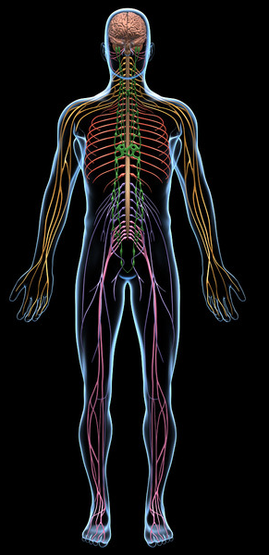
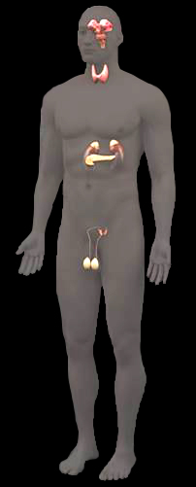
Control and co-ordination
are of two types
Nervous control
Chemical control

Slide 3
Nervous control generates
Chemical control generates
Nerve impulses
Chemicals or hormones
Both systems work in coordination
to integrate and control various body activities like
Playing
Running
Walking

Slide 4
Nervous system generate electric impulses.
Endocrine system generate hormones.
Nerve impulses are rapid and are usually of short duration.
Hormonal action is much slower and long lasting.

Slide 5
Thank You

